Slide 1
BUSINESS 100
Corporate Structures
BUS 100 Fall 2013
Chapter 4
Slide <number>

Slide 2
Learning Objectives – Ch 4
Forms of Business ownership
List the advantages and disadvantages of sole proprietorships.
Describe the advantages and disadvantages of partnerships. Include the differences between general and limited partners.
Discuss the advantages and disadvantages of corporations.

Slide 3
Learning Objectives cont.
4. Outline the advantages and disadvantages of franchises, and discuss the challenges of global franchising.

Slide 4
LO1 Starting a Small Business
Sole Proprietorship: a business that is owned, and usually managed, by one person.
Partnership: a legal form of business with two or more parties.
Corporation: a federal or provincial chartered legal entity with authority to act and have liability separate from its owners.
Franchise: the right to use a specific business’s name and sell its goods and services in a given territory.

Slide 5
LO1 Starting a Small Business
Liability: includes the responsibility of a business to pay all normal debts and to pay because of a court order or law, for performance under a contract, or payment of damages to a person or property in an accident.
Limited liability: the responsibility of a business’s owners for losses only up to the amount they invest (limited partners and shareholders).
Limited liability partnership (LLP): limits partners’ risk of losing their personal assets to only their own acts and omissions, including those under their supervision.

Slide 6
Sole Proprietorship
Advantages
Disadvantages
Ease of starting and ending
Be your own boss
Pride of ownership
Retain profit
No special taxes
Less regulation
Limited financial resources
Management difficulties
Overwhelming time commitment
Few fringe benefits
Limited growth
Limited lifespan
Possibly pay higher taxes
Unlimited liability

Slide 7
Partnerships
Advantages
Disadvantages
Unlimited liability
Division of profits
Disagreements among partners
Difficulty of
termination
Possibility of higher taxes
More financial resources
Shared management and pooled, complementary skills and knowledge
Longer survival
Shared risk
No special taxes

Slide 8
Corporations
Advantages
Disadvantages
Limited liability
More money for investment
Size: may be larger due to increased resources
Perpetual life
Ease of ownership change
Ease of attracting talented employees
Separation of ownership from management
High initial costs
Extensive paperwork
Double taxation
Two tax returns
Size: may become too inflexible to new ideas
Termination difficult
Stockholder and board conflict

Slide 9
Franchises
Advantages
Disadvantages
Management and marketing assistance
Personal ownership
Nationally recognized name
Financial advice and assistance
Lower failure rate
Large start-up costs
Shared profit
Management regulation
Coattail effects
Restrictions on selling
Fraudulent franchisors

Slide 10
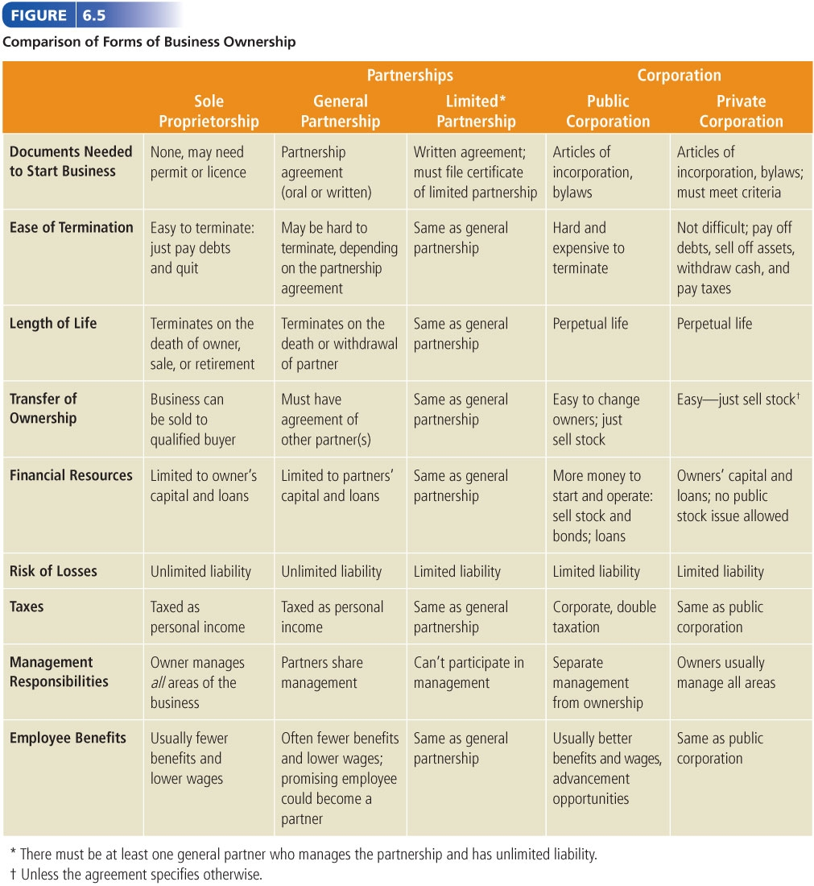
Comparison of Forms of Business Ownership
[Catch Figure 6.5)

Slide 11
Joe wants to quit his job and start up his own business. He is 100% certain he is going to win the lottery in 5 years so he is only interested in having his business for the next 5 years. His other friends have told him that he could save a lot of money on income taxes if he started his own business. He doesn’t know how to set up his business form so he is coming to you for assistance. Given what Joe has told you, what business form would you recommend? Please explain to Joe why you are recommending this business as well as the advantages and disadvantages of this business form.

